Slide 1


Bank of Baroda Hackathon - 2022
Technology Partner
Team Name : Star Techies
Team bio: We, enthusiastic young learners of AI & ML, gave our best to provide a better solution to the given use case 'Virtual Assistant'.
Date : 20-Sep-2022

Slide 2
Problem Statement?
Why did you decide to solve this Problem statement?
1. Physically Challenged are No more Challenged
Virtual assistants make it possible for blind or visually impaired people to use only their voice to navigate into their accounts and get what they want in no time.
2. All In One Account Manager
With virtual assistants incorporated into the device, banks may be unfastened with very crucial and steeply-priced touch middle time, further saving customers time through presenting short responses to all their Account Related Queries in place of making them wait unnecessarily.
3. Balance Check
Virtual assistants in banking can work much like live ones and provide customers with information on their account balances as well as a brief overview of their daily transactions.

Slide 3
4. Personalized Assistance
Undoubtedly, virtual banking assistants can notify customers with deposit alerts, and reminders on transfers and help them in providing information related to any banking services like credit cards, loans, etc.
5. Financial Assistance
Banking virtual assistants can act like financial advisors if they are integrated with the appropriate historical data. They can assist clients with managing their finances by responding to chat requests from customers regarding spending and budgeting.
6. Customer Support
Banking virtual assistants can provide various customer support services in addition to fundamental banking functions, such as fraud detection, adding or removing payees, setting up periodic bill payments, checking account overdrafts, and more.

Slide 4

User Segment & Pain Points
Which user /advertiser segment would be early adopter of your product & why?
Integrated as an API in Banking applications (Like Web app, Mobile app etc.,)

Slide 5
Pre-Requisite
What are the alternatives/competitive products for the problem you are solving?
Already existing Chatbot support provided in various banking applications.

Slide 6
Azure tools or resources
Azure tools or resources which are likely to be used by you for the prototype, if your idea gets selected AZURE BOT SERVICE FRAMEWORK: The Azure Bot service is an AI chatbot that offers a variety of ways to build bots utilizing its fundamental tools, such as the Bot Framework SDK for building bots and the bot service for connecting bots to channels. An Azure cloud service is offered by an AI bot.

Slide 7
Any Supporting Functional Documents
Present your solution, talk about methodology, architecture & scalability
Solution:
An A.I powered banking virtual assistant that can handle payments and transfers, credit card activation, password resets and other customer services not only to normal people but also to the differently-abled persons too using it’s voice assistance feature.
Methodology:
Our IVA(Intelligent Virtual Assistant) is built mainly using 3 Python Libraries:
1. Python Speech Recognition: This library transforms the audio signals into a comprehensive computer-readable format. We can also refer to it as a spectrogram. It is a 3D graph with frequency on the Y-axis, time on the X-axis, and color denoting strength.
2. Pyttsx3: This conservation library in Python translates text to speech.
3. PyAudio: With Pyaudio from Python, you can play and record audio quickly on several devices.

Slide 8
Any Supporting Functional Documents
Present your solution, talk about methodology, architecture & scalability
Our solution model is implemented using the following steps:
Step-1: Import the required Python modules.
Step-2: Create two voice communication functions, one for listening and another for responding.
Step-3: Create voiced responses to the kinds of questions you want your assistant to answer.
Step-4: Create the lookup routines the virtual assistant will perform when asked a specific question.
Step-5: Train our A.I model using huge datasets such as Coached Conversational Preference Elicitation (CCPE) and Taskmaster-1 of Google.
Step-6: Test the model via real-time applications & implementations.

Slide 9
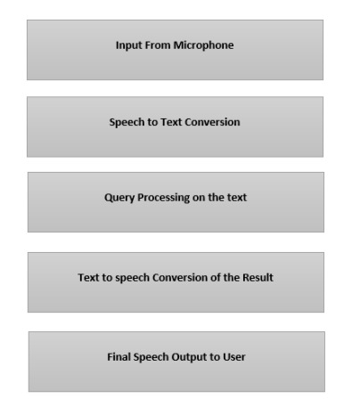
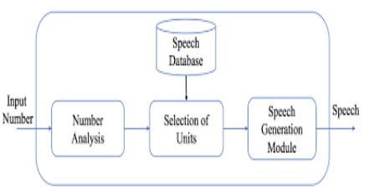
Any Supporting Functional Documents
Present your solution, talk about methodology, architecture & scalability
ARCHITECTURE:
Flow Of Events

Slide 10
Thank You
Sruthika B S
Sakthi Siddharth N
Tamilvizhi R
Shevani V J

